Slide 1

Can we talk about hypotheses?
Dan Howarth Senior content designer, DWP
Notes:
I’m Dan Howarth, I’m a content designer at the Department for Work and Pensions.
I wondered if we could have a chat about hypotheses. This is a cut down version of a longer talk. When I showed it to a mate the other day, they said “Aren’t hypotheses a given? Don’t we always work that way?”

Slide 2
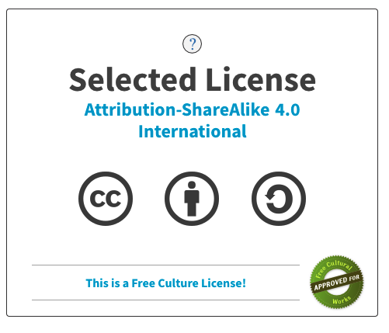

Notes:
This slide deck has a Creative Commons license, so you can use it and share it. The license is called ‘Attribution-ShareAlike 4.0 International’.
It means you can adapt and share this work for your own purposes – as long as you credit the author (Dan Howarth) and add this license so others can share your work, too.
Full details of the license are at: https://creativecommons.org/licenses/by-sa/4.0/

Slide 3

We use ‘assumption’ and ‘hypothesis’ interchangeably.
We also rarely use ‘hypothesis’ correctly, often referring to laughably vague statements as hypotheses
Notes:
I love this quote from Tristan Kromer at lean coaches, Kromatic. He says [read from screen]. Does that sound familiar?
We sort of use hypotheses all the time. We have a theory about how to solve a problem, and then try it.
All teams do it slightly differently, and some more informally. We don’t always write them down, and we don’t always revisit them.
Hypothesis-driven design is a really powerful technique for building the right thing, documenting that knowledge and telling the story of it. So how can we make full use of it?
// References
https://kromatic.com/blog/assumption-vs-hypothesis-to-the-death/

Slide 4

Notes:
First and foremost, hypothesis-driven design is about learning. It helps the team learn what their service needs to do to meet user needs and business requirements.
Johnny 5 knows it. Every output needs input.

Slide 5
Jeff Gothelf on hypotheses:
Each design is a proposed business solution – a hypothesis. Your goal is to validate the proposed solution as efficiently as possible by using customer feedback
Notes:
Jeff Gothelf [gott–helf], who’s the co-author of Lean UX, said that a hypothesis IS your design. He said: [read from screen]
But it’s a way of documenting your design and the process behind it.
// References
Gothelf, J. and Seiden, J. (2013). Lean UX: Applying Lean Principles to Improve User Experience. USA: O’Reilly

Slide 6
We’ve seen that... (observation)
We think this is because... (insight)
So if we... (feature / idea)
We’ll see... (outcome)
We’ll know this is true when... (metric)
Notes:
Here’s the structure of a typical hypothesis – if you write it down. There are 5 different elements, which have a flow.
People use many different formats. This is how I like to do it – for a reason
A hypothesis is a living document, that evolves as you learn more about the problem you’re working on and how to solve it. So it also represents the work you’ve done at each stage of your design process.
Let’s look at each line in a bit more detail.

Slide 7
Line # 1
We’ve seen that...
– observation / data about users
Notes:
The first line – “we’ve seen that” – is an observation about a user, or a user behaviour, from user research or quantitative data.
Note that it’s clear about who the user is that this hypothesis relates to.

Slide 8
Line # 2
We think this is because...
– insight from analysis
Notes:
The second line – “We think this is because” – is an insight from analysing the observed behaviour, which reveals the underlying motivations behind it.

Slide 9
Line # 3
So if we...
– feature / iteration
Notes:
The third line – “so if we” – is the feature or iteration that we’re proposing to solve the problem. The thing we prototype.

Slide 10
Line # 4
We’ll see…
– user outcome
Notes:
Then “We’ll see…” is the user outcome we’re looking for – what’s the user behaviour the feature has enabled to meet the user need?

Slide 11
Josh Seiden on outcomes:
Outcomes are the human behaviours that drive business results… [they] happen when you deliver the right features
Seiden (2019: 14)
Notes:
Josh Seiden [sigh-don], the other co-author of Lean UX, said this about outcomes: [read from screen]
So they’re a crucial part of a hypothesis.
// References
Seiden, J (2019). Outcomes Over Outputs. USA: Sense and Respond Press

Slide 12
Line # 5
We’ll know this is true when…
– metric (qual or quant, or both)
Notes:
Finally the last line – “we’ll know this is true when…” is the metric that’ll show if we’re right or not. It’s how we measure the outcomes.
This could be a qualitative metric from user research or usability testing. Or a quantitative metric from data, web analytics or – dare I say – management information from the business.
Or both. Jane Wilkinson at DWP calls this “triangulation of metrics”. Using qual and quant together, so you’re not just relying on one metric, and thus reducing any bias in your results.
So those are the 5 parts of a hypothesis. I know there are variations, but this is how I try to do it.

Slide 13

Understand
Analyse
Design
Test
We’ve seen that...
We think this is because...
So if we...
Test it
We’ll know this is true when…
We’ll see…
Notes:
We build the hypothesis through each stage of the design process. So it could become a design workflow in Jira – on a Kanban board.
We pick up a piece of work from the backlog. We investigate the problem and do some research [Click] It yields some research observations and data.
[Click] We analyse it as a team and produce an insight about why that’s happening, and develop our understanding of the user need. We also establish the outcome – the user behaviour that will meet the business requirement
[Click] Then we ideate possible solutions – maybe this is pair-writing with a subject matter expert, or some other co-design activity. We prototype it, and we decide how we’ll measure it.
[Click] Then we test it.
So we’re developing the hypothesis as we move along the board.

Slide 14
Ben Holliday on hypothesis-driven design:
It helps teams take calculated risks to move a product forward (be iterative) and meet user needs. The important thing is to write things down. The hard part is being brave and designing good experiments
Notes:
Ben Holliday – head of design at FutureGov – said that hypothesis-driven design “helps teams take… [read rest from screen]”
// References
https://www.hollidazed.co.uk/2015/07/16/everything-is-hypothesis-driven-design/

Slide 15

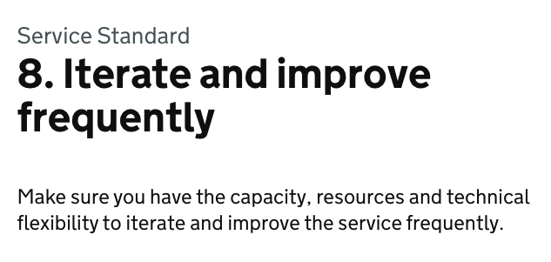
Notes:
How you iterate a service is part of the Service Standard. In a GDS assessment, we need to be able to be able to talk about what we’ve learned from things we’ve thrown away – as much as what we’ve built.
Framing the work we’ve done as hypotheses is a useful way of telling that story.
It also keeps us honest about meeting user needs. It shows where decisions are based on evidence or assumptions – and allows us to keep ‘tactical solutions’ in view, so we can iterate them.

Slide 16

Hypotheses show shared understanding
Notes:
So in summary, hypothesis-driven design is a powerful tool.
It shows the team have shared understanding about what we’re building and why.
We’re working towards the same outcomes, and have the same idea of what success looks like.

Slide 17
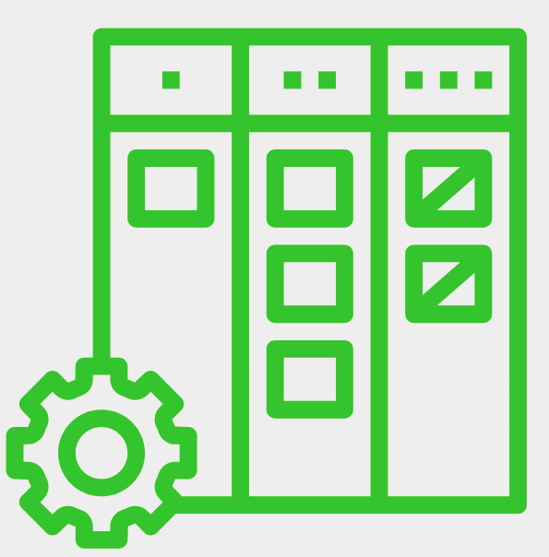
We can use them as a design workflow
Notes:
We can use hypotheses as a design workflow – and build them as we move tickets through a Jira board. Using hypotheses to work in the open lets the whole team understand the work – and it reduces the risk of rework at development stage, and beyond.

Slide 18
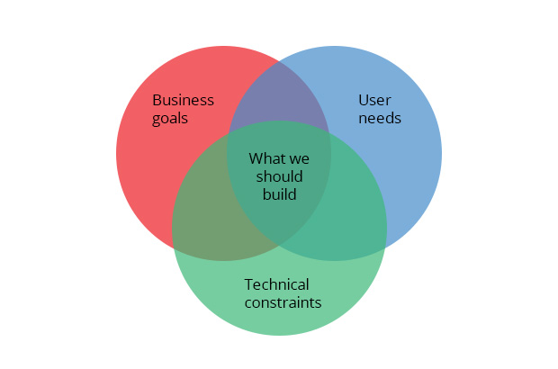
They let us build better stuff
Notes:
They let us build better stuff. We can reconcile user needs, business requirements and technical constraints, and be clear about the space we have to work in.
They let us openly measure what we’re doing, and see if the solution works. If it doesn’t work…

Slide 19

Hypotheses enable us to be iterative
Notes:
We can iterate it. Hypotheses give us a framework for iteration. If we need a quick fix now, we can document it and validate our assumptions later. And we can go back and iterate everything that’s based on assumption or knowledge that’s now out of date.

Slide 20

Hypotheses let us share what we learn
Notes:
As well as helping us plan what we need to learn, and then prototype and test ideas – hypotheses also let us share what we learn.
They’re also a useful way of talking about why we did things the way we did. They’re a repeatable, sharable method.
It might be a useful way to frame updates in show and tell, for example. They also might be good for orientating new members of staff, and handing services over to new teams – so they can pick up where we left off.

Slide 21
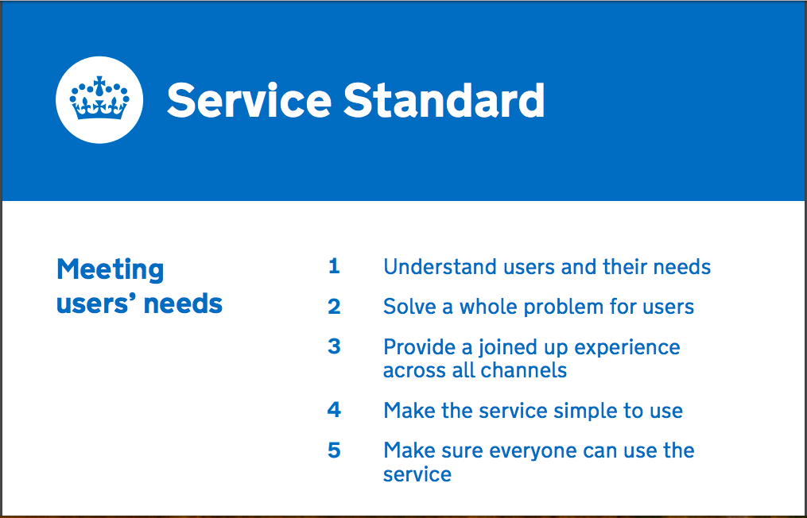
They’re helpful for your GDS assessment
Notes:
Likewise, they’re useful to talk about in your GDS Service Standard assessment.
We shouldn’t have to cram in the way we do to prepare for assessments. We just need to tell the story of our service and how it’s evolved to meet user needs and other points in the Service Standard. If we’re in the habit of documenting as we go, it helps us tell that story.
When we did the beta assessment for Apply for New Style ESA, we found talking through hypotheses to be a helpful way of framing our responses.

Slide 22
Thanks 👋
Let’s have a chat
Notes:
Thanks for listening. Let’s have a chat, and see if anyone’s put anything in Menti

